Slide 2
Round 1 & round 4 PRACTICE QUESTIONS
GENERAL MATHEMATICS QUESTIONS

Slide 3
Order these from the calculation with the largest value
to the calculation with the smallest value.
(answer in the form of D, B, A, C)
1$\frac{2}{8}$ – $\frac{3}{8}$
2$\frac{4}{8}$ – $\frac{6}{8}$
$\frac{3}{8}$ + $\frac{5}{8}$
$\frac{6}{8}$ + $\frac{5}{8}$
Notes:
A) 7/8
B) 14/8 or 1 6/8
C) 8/8 or 1
D) 11/8 or 1 3/8
B, D, C, A

Slide 4
Which of these numbers has the most factors?
24
30
36
47
Notes:
24 – 1, 2, 3, 4, 6, 8, 12, 24
30 – 1, 2, 3, 5, 6, 10, 15, 30
36 – 1, 2, 3, 4, 6, 9, 12, 18, 36
47 – 1, 47

Slide 5
What is the combined value of the coins
collected by the children?
20p coins
50p coins
Notes:
Ahmed:
12 x 20p coins = £2.40
13 x 50p coins = £6.50
Total: £8.90
Jasper:
15 x 20p coins = £3.00
18 x 50p coins = £9.00
Total: £12.00
Combined value = £20.90

Slide 6
Put these in order, starting with the smallest answer.
(answer in the form of D, B, A, C)
2308 + 4699
7100 ÷ 1
8003 – 3079
825 x 9
Notes:
A) 7,007
B) 7,100
C) 4,924
D) 7,425
C, A, B, D

Slide 7
The perimeter of
this shape is 48cm.
What is the perimeter of
this shape?
Notes:
22 x 8 = 176cm

Slide 8
The same digit is hidden by the squares.
What is the digit?
 | 6 | ? | 8 | 1
- | ? | 4 | 6 | 9
 | 3 | 8 | 1 | ?
Notes:
6281 – 2469 = 3812
Missing digit – 2

Slide 9
A shop has a sale on.
Buy 1 box of cupcakes and get a 2nd box for $\frac{1}{3}$ of the price.
Leni buys this box of cupcakes
and gets another box in the sale.
What is the cost per cupcake?
£18
Notes:
£18 + £6 = £24
Cost per cupcake = £1

Slide 10
B
A
C
Which shape has the most lines of symmetry?
Answer using the shape letter.
D
F
E
Notes:
Lines of symmetry:
A has 1
B has 5
C has 3
D has 0
E has 2
F has 1
B has the most.

Slide 11
Round 2 PRACTICE QUESTIONS
THE ESTIMATION ROUND

Slide 12
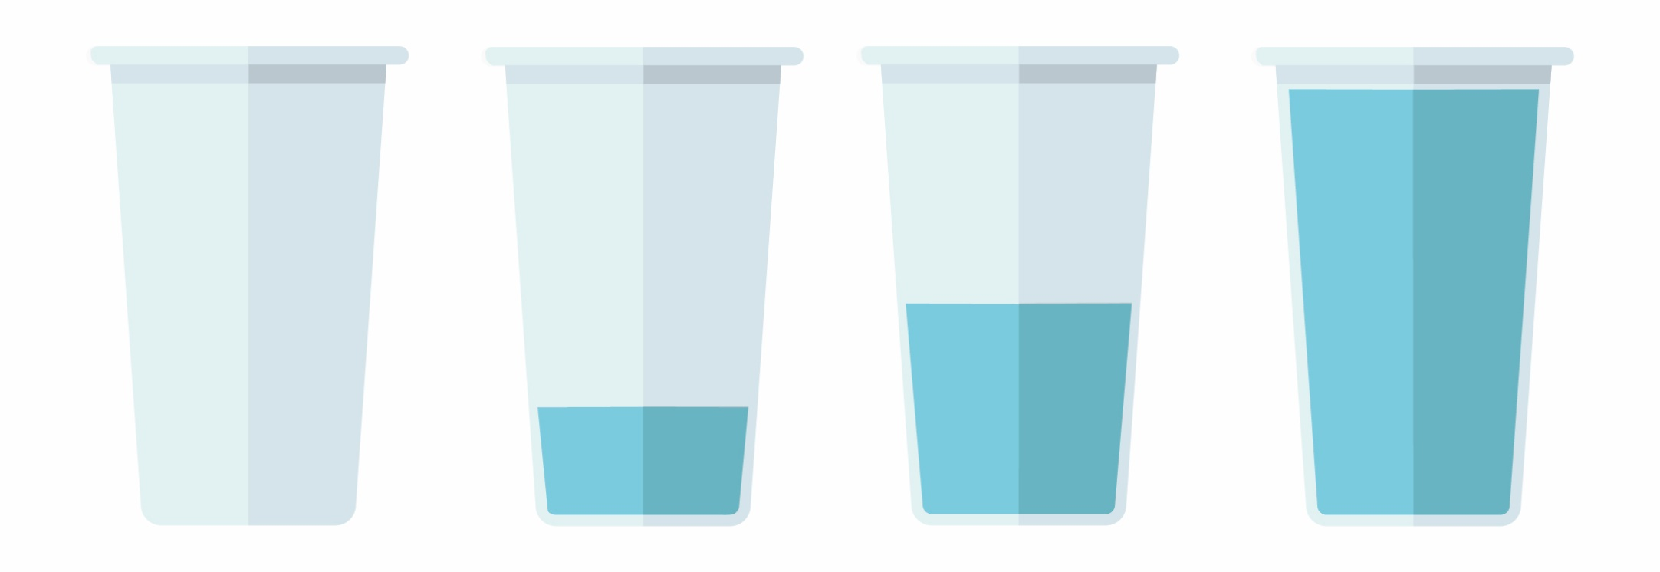
Estimate how much water is in all 4 glasses altogether.
125ml
Notes:
Cup 1 = 0 ml
Cup 2 = approx. 60 ml
Cup 3 = 125 ml
Cup 4 = approx. 260 ml
Approx total = 445 ml

Slide 13
2.46
What is the value at point W on this zigzag number line?
2.63
154
W
P
Notes:
W = approx. 2.97

Slide 14
Round 3 (PRE-ROUND CHALLENGE) PRACTICE QUESTION
SPOT THE SHAPE!

Slide 15
The pre-round: spot the shape
Pupils should complete their ‘Spot the Shape’ challenge before their heat.
There is no time limit for solving this. We anticipate that it will take around 15 minutes to complete.
If you have any questions, please email:
primarymaths@hfleducation.org

Slide 16
How many quadrilaterals are in the picture?

Slide 17
How many quadrilaterals are in the picture?
F
J
E
A – B – G – F – A
A- B – J – F – A
A – B – H – G – A
A – B – H – F – A
A – B – C – G – A
A – B – C – F – A
A – G – J – F – A
A – I – E – F – A
B – C – D – I – B
B – I – E – J – B
C – D – I – H – C
C – D – I – G – C
I – E – J – G – I
I – E – F – G – I
I
G
A
H
D
B
C
There are 14 quadrilaterals in the picture.

Slide 18
How many quadrilaterals are in the picture?
There are 14 quadrilaterals
in the picture.

