Slide 1
HFL EDUCATION YEAR 5 MATHS CHALLENGE

Slide 2
Round 1 & round 4 PRACTICE QUESTIONS
GENERAL MATHEMATICS QUESTIONS

Slide 3
Put these in order, starting with the smallest answer.
(answer in the form of D, B, A, C)
87 ÷ 3
$\frac{3}{10}$ of 90
2.8 x 9
26% of 120
Notes:
A) 29
B) 27
C) 25.2
D) 31.2
C, B, A, D

Slide 4
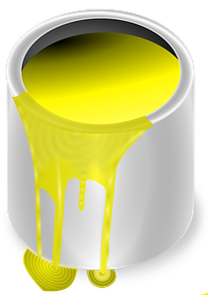
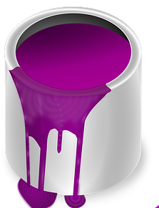
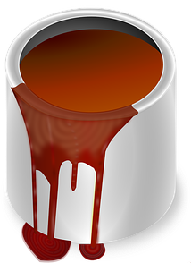
These are the volumes of paint left in 3 containers.
How much paint is there in total?
1.2 litres
2 $\frac{4}{5}$ litres
375 ml
Notes:
1200 ml
2800 ml
375 ml
Total volume: 4375ml or 4.375ml

Slide 5
Order these calculations from smallest to largest answer.
(answer in the form of D, B, A, C)
49.2 ÷ 6 =
15.3 – 2.75 – 4.25 =
3 x 0.45 x 6 =
4.62 + 2.9 + 0.83 =
Notes:
49.2 ÷ 6 = 8.2
15. 3 – 2. 75 – 4.25 = 8.3
3 x 0.45 x 6 = 8.1
4. 62 + 2.9 + 0.83 = 8.35
C, A, B, D

Slide 6
Which ‘chain’ ends in the lowest value?
Start 50 | ÷ 5 | – 3 | Treble it | $\frac{1}{2}$ of it |  | End ?
Start 1.25 | x 4 | + 183 | $\frac{1}{4}$ of it | ÷ 5 |  | End ?
Start 31.8 | + 5.2 | ÷ 4 | – 0.75 | x 1.1 |  | End ?
Notes:
50 ÷ 5, – 3, treble it, half of it = 10.5
10, 7, 21, 10.5
B. Start at 1.25, x 4, + 183, ¼ of it, ÷ 5 = 9.4
5, 188, 47, 9.4
C. Start 31.8, + 5.2, ÷ 4, - 0.75, x 1.1 = 9.35
37, 9.25 8.5
ANSWER IS C IS LOWEST

Slide 7
The area of this shape is 90 cm².
Work out the length marked a.
20 cm
7 cm
a
4 cm
(not drawn to scale)
Notes:
12.5 cm

Slide 8
The hidden digits are all the same.
What are they?
1 3 5 3 ÷ 1 1 = 1 2 3
Notes:
1 3 5 3 ÷ 1 1 = 1 2 3
Missing digits are 3

Slide 9
What time did train D arrive in London?
Station | Train A | Train B | Train C | Train D
Manchester | 09:37 | 10:17 | 11:35 | 12:41
Birmingham | 10:51 | 11:31 | 12:49 | 13:55
Milton Keynes | 11:39 | 12:19 | 13:37 | 14:43
London | 12:26 | 13:06 | 14:24 | 15:30
Notes:
Train D arrives at 15:30

Slide 10
What is the value of ?
 |  |  | 13.25
 |  |  | 12.75
 |  |  | 13
13 | 13.5 | 12.5
Notes:
Square = 4.5
Circle = 4.25
Pentagon = 4

Slide 11
Round 2 PRACTICE QUESTIONS
THE ESTIMATION ROUND

Slide 12
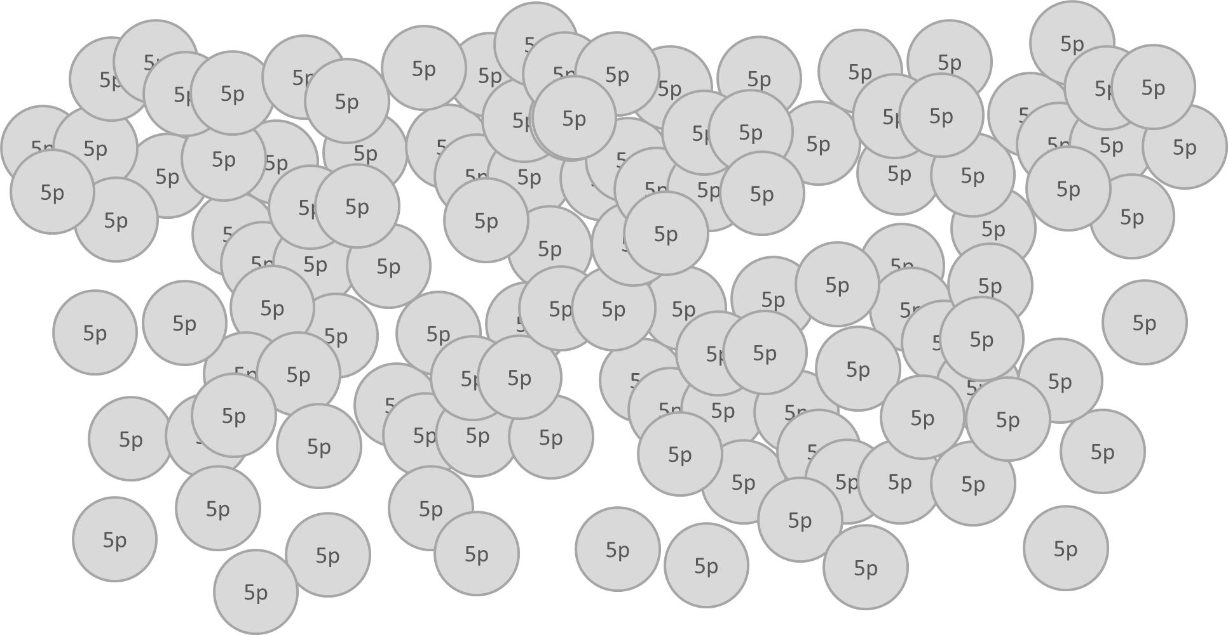
Estimate the total monetary value.
Notes:
10 points £6-£6.30
8 points £5.70 - £6.60
6 points £5.40 - £6.90
4 points £5.10 - £7.20
2 points £4.80 - £7.50

Slide 13
How many triangles would be needed
to cover the rectangle?
Notes:
Rectangle = 390cm2
Triangle = 3x4 so area = 6cm2
So 65 triangles

Slide 14
Round 3 PRACTICE QUESTIONS
PERPLEXING PUZZLES

Slide 15
rules
Teams should complete this round in school BEFORE THEIR HEAT.
There is a time limit of 30 minutes for this round.
Teams should be provided with all 3 puzzles at the same time.
Teams can choose to solve the puzzles in any order.
Teams can decide how long to spend tackling each puzzle but must agree their final answers within the 30-minute time limit.
Points will be awarded for correct answers and part answers.
Puzzle | Maximum points available
A | 10
B | 15
C | 20

Slide 16
Perplexing Puzzle A
(practice)
10 points
Niko is thinking of a whole number.
He multiples it by 7.
Then he subtracts 64.
$\frac{1}{5}$ of this number is 11.
What number did Niko first think of?
Notes:
11 x 5 = 55
55 + 64 = 119
119/7 = 17

Slide 17
Perplexing Puzzle B
(practice)
15 points
Each column and row of shapes has a value of 14.4.
What is the value of each shape?
Notes:
Circle = 14.4/3 = 4.8
Square = 14.4 – 4.8 / 2 = 4.8
Triangle = 14.4 – (2 x 4.8) /3 = 1.6
Hexagon = 14.4 – 1.6 – 4.8 / 2 = 4

Slide 18
Perplexing Puzzle C
(practice)
20 points
Sami is building a pattern with lollipop sticks.
Each lollipop stick is 7cm long.
If Sami builds a pattern with 50 hexagons, what will the perimeter of the shape be?
Give your answer in cm.
Notes:
50 hexagons = 251 lollipop sticks (50 x 5 + 1)
251 – 49 internal lollipop sticks = 202
202 sticks x 7cm = 1414cm

