Slide 1
Round 1 & round 4 PRACTICE QUESTIONS
GENERAL MATHEMATICS QUESTIONS

Slide 2
Order these multiplications from largest to smallest product.
(answer in the form of D, B, A, C)
2 x 12 x 2
2 x 3 x 4
8 x 2 x 5
10 x 7 x 1
Notes:
A) 2 x 12 x 2 = 48
B) 2 x 3 x 4 = 24
C) 8 x 5 x 2 = 80
D) 10 x 7 x 1 = 70
C, D, A, B

Slide 3
Order these shapes by perimeter length
(shortest perimeter to longest).
(answer in the form of D, B, A, C)
a regular pentagon where each side is 6cm in length
a triangle with sides of 12cm, 24cm and 18cm
a square where each side is 15cm
a rectangle where the shorter sides are 8cm each and the longer sides are 13cm each
Notes:
A) 5 x 6 = 30cm
B) 12 + 18 + 24 = 54cm
C) 15 x 4 = 60cm
D) 8 + 8 + 13 + 13 = 42cm
A, D, B, C

Slide 4
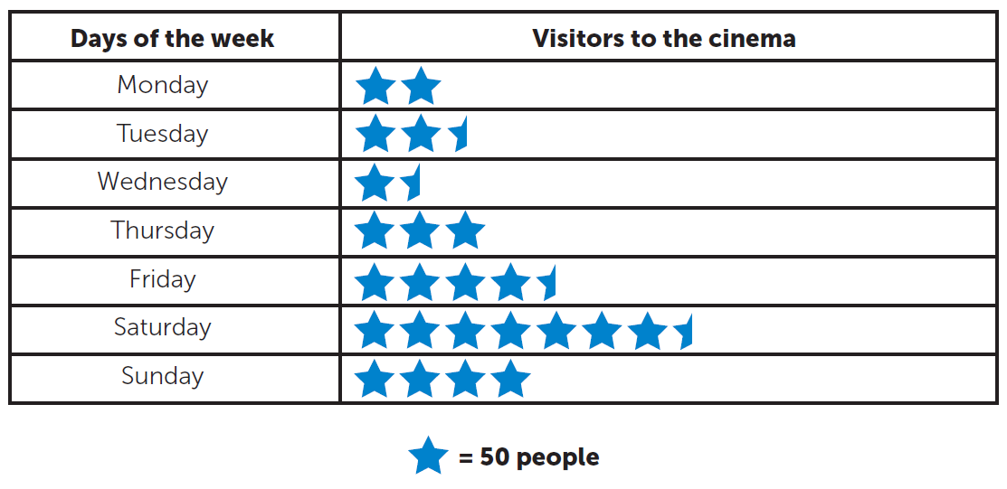
If each visitor spent £2 on a bottle of water, on which day would the cinema make closest to £310 in water sales?
Notes:
Monday – 100 x £2 = £200
Tuesday 125 x £2 = £250
Wednesday – 75 x £2 = £150
Thursday – 150 x £2 = £300
Friday – 225 x £2 = £450
Saturday – 375 x £2 = £750
Sunday – 200 x £2 = £400

Slide 5
Put these in order, starting with the smallest answer.
(answer in the form of D, B, A, C)
$\frac{2}{4}$ of 90
9 x 3
47 – 9
25 + 26
Notes:
A) 45
B) 27
C) 38
D) 51
B, C, A, D

Slide 6
X | 16 | 47
 |  |  | 47
 |  |  | 33
 |  |  | 15
Each picture stands for a number.
The row and column totals are shown.
Find the value of x.
Notes:
Strawberry = 5
Orange = 6
Gingerbread man = 21
X = 32

Slide 7
The same digit is hidden by the paint splodges.
What is the digit?
 | 3 | 6 | 2
+ | 2 | 4 | 6
 | 6 | 0 | 8
Notes:
362 + 246 = 608
Missing digit – 6

Slide 8
Jamie is serving orange juice at a party.
Each carton serves 4 people.
There are 29 guests coming.
How many cartons will Jamie need to buy?
Notes:
7 cartons would serve 28 guests
8 cartons would be needed

Slide 9
What two calculations does the robot do?
5
6
7
8
?
9
11
13
15
?
Notes:
x2 – 1

Slide 10
Round 2 PRACTICE QUESTIONS
THE ESTIMATION ROUND

Slide 11
Estimate how many bees are in the picture.
Notes:
There are 84 bees in the picture.

Slide 12
137
What is the value at point P on this zigzag number line?
154
P
Notes:
P = 186

Slide 13
Round 3 (PRE-ROUND) PRACTICE QUESTION
SPOT THE SHAPE!

Slide 14
The pre-round: ‘Spot the Shape’
• There is one round for pupils to complete before the heat. This is the ‘Spot the Shape’ round.
• There is no time limit for this question. We anticipate that it will take around 15 minutes to complete.
• The team’s answer will be submitted on the Google Form during the live event. This will be explained at the beginning of the heat. This is an example to practice.

Slide 15
How many triangles are in the picture?

Slide 16
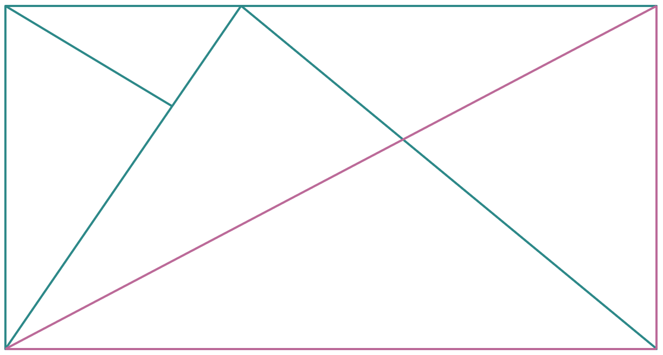
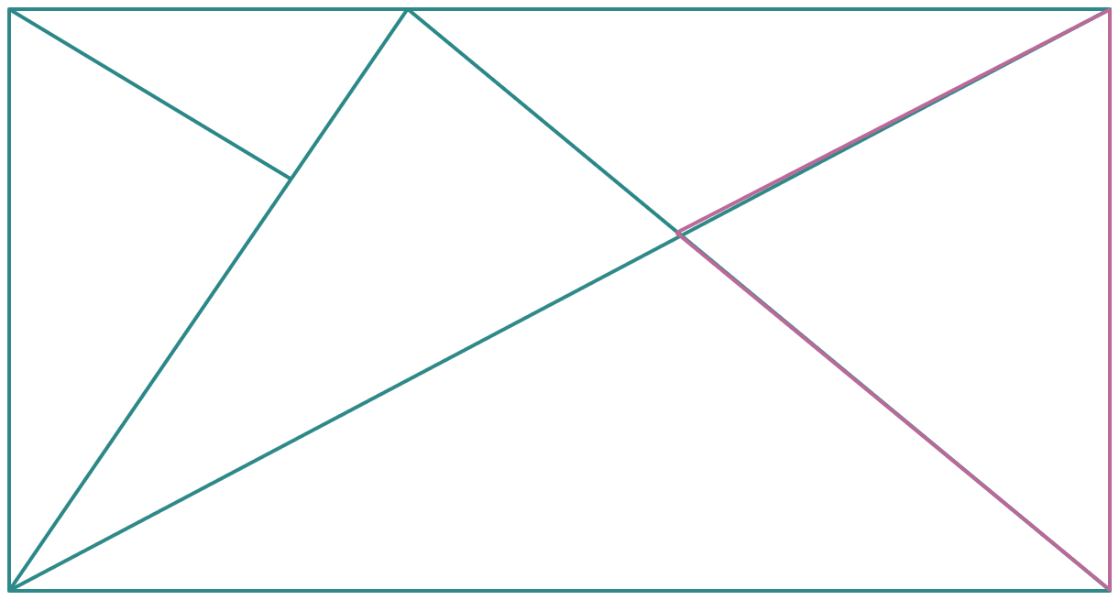
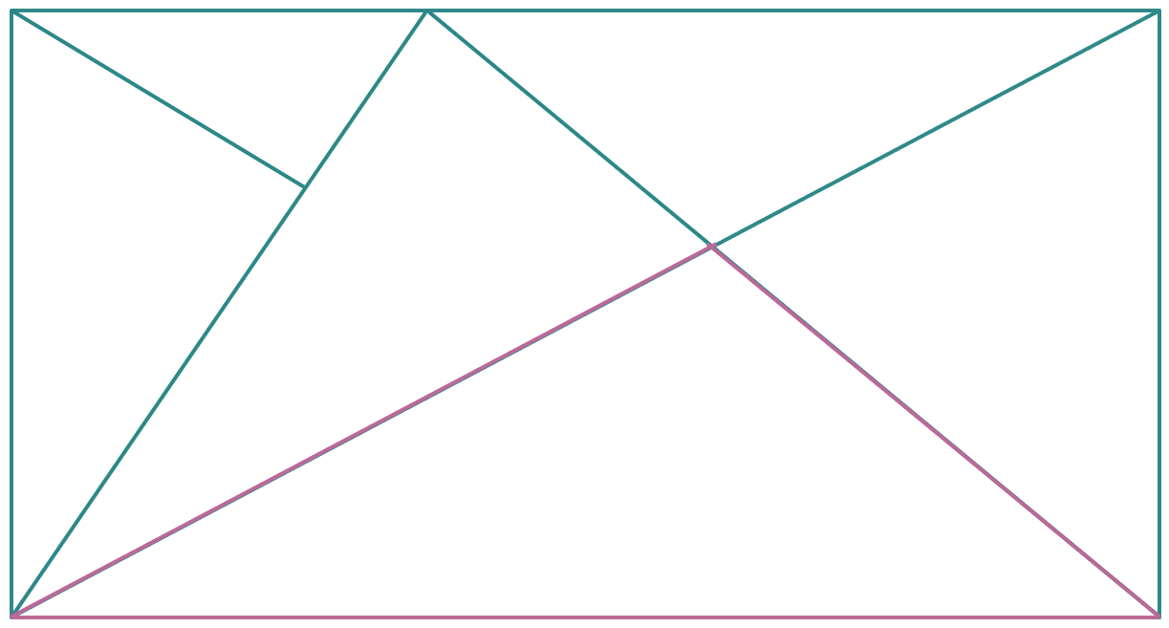
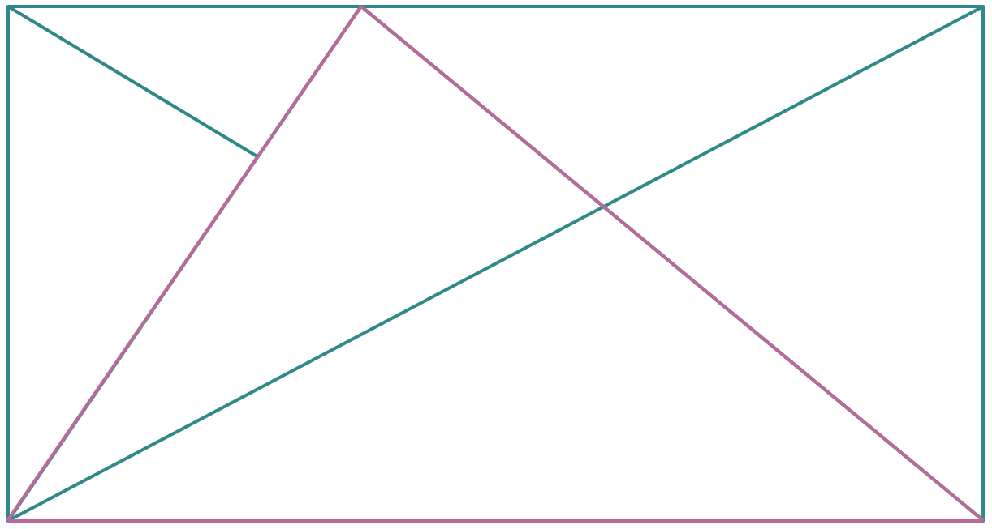
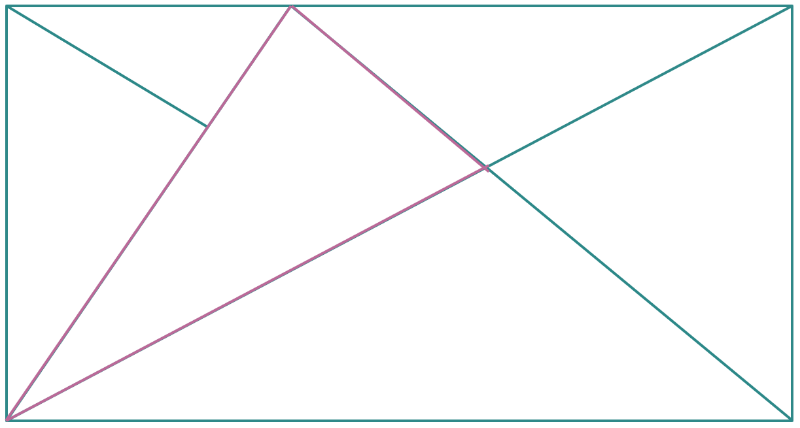
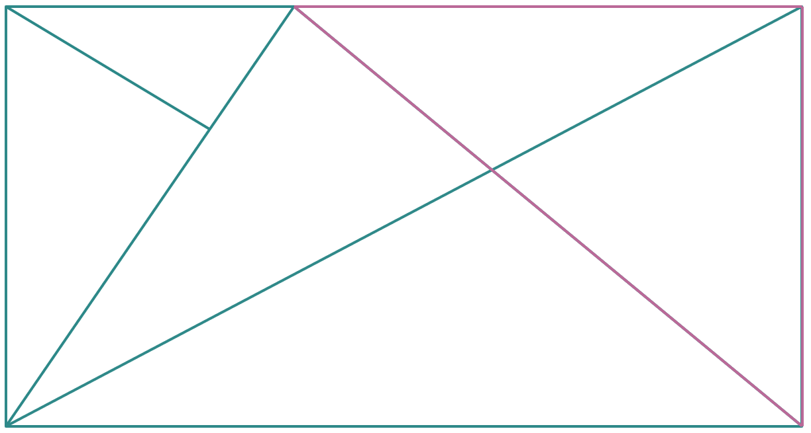
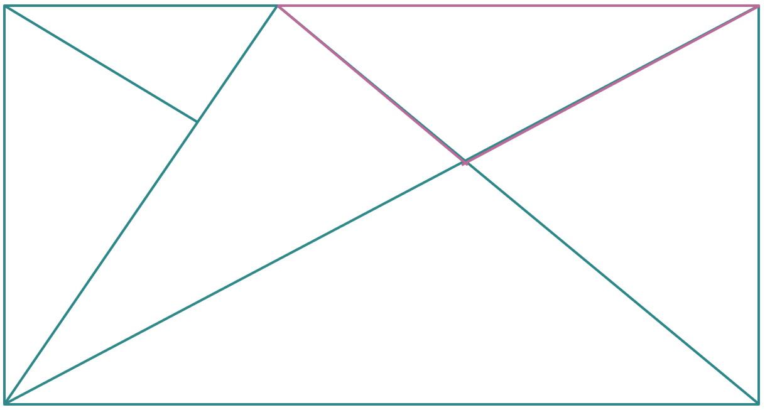
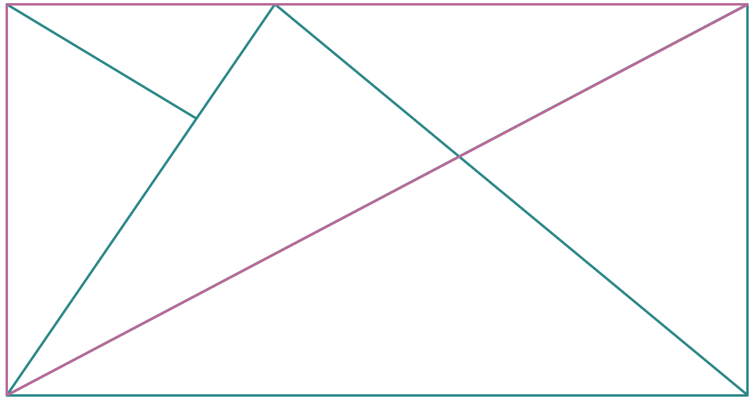
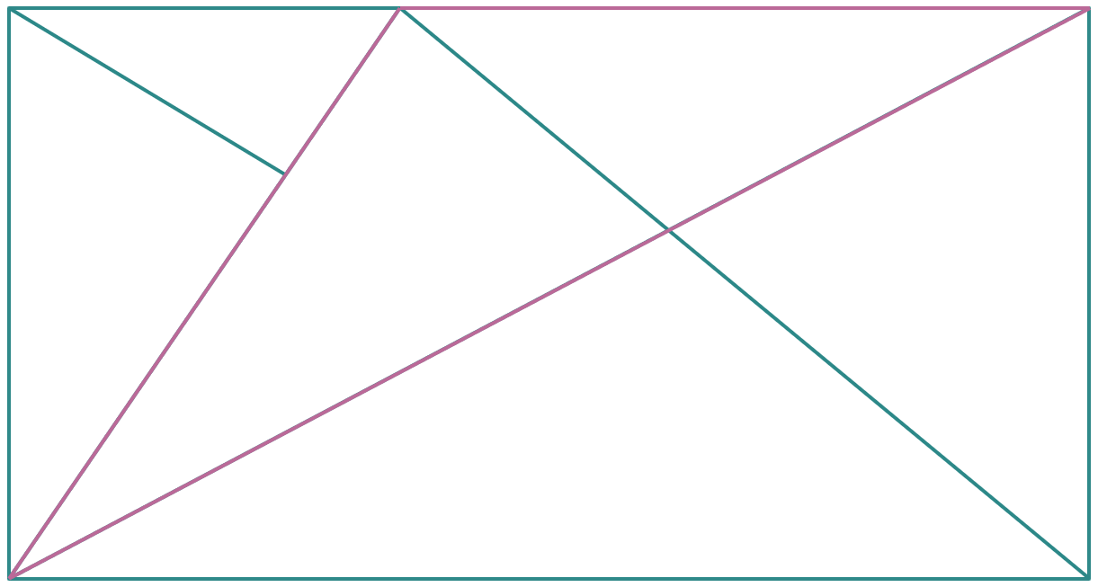
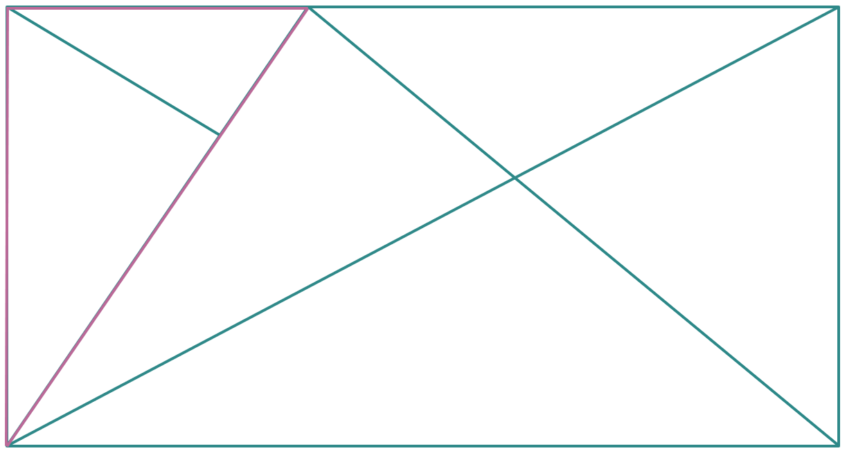
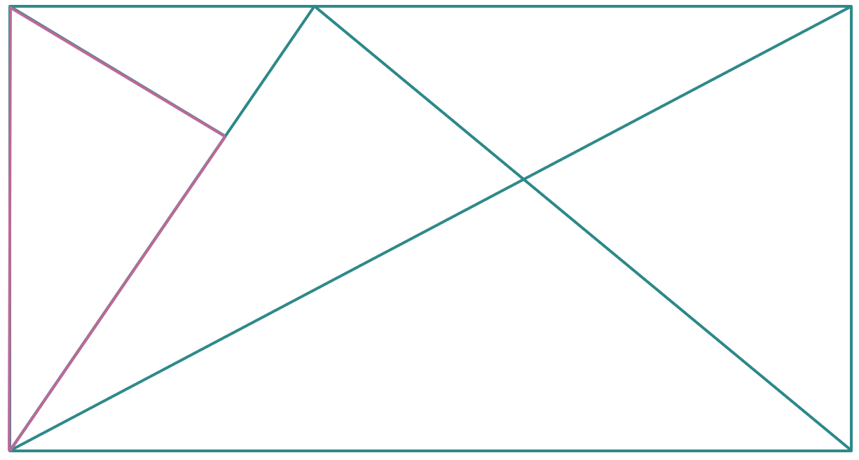
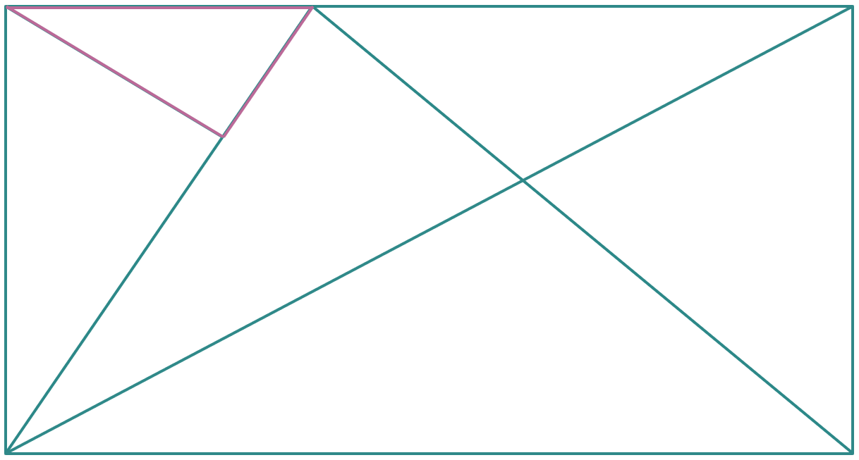
How many triangles are in the picture?
How many triangles are in the picture?
There are 12 triangles in the picture.
Notes:
There are 12 triangles in the picture.

